Slide 1


Green Pace
Security Policy Presentation
Developer: Dexter Melton

Slide 2

OVERVIEW: DEFENSE IN DEPTH
The Green Pace Secure Development Policy creates a unified, organization-wide approach to secure software development. As the development team expands, consistent standards are necessary to ensure all applications meet the same security baseline. This policy formalizes the principles, coding standards, and best practices that developers already follow informally, making sure they are documented, repeatable, and enforceable.
The policy enhances Green Pace’s defense-in-depth strategy by establishing layered protections throughout design, coding, testing, deployment, and operations. By implementing security controls at each stage of the development process, Green Pace minimizes the attack surface, predicts adversarial actions, and stops vulnerabilities from reaching production.

Slide 3
THREATS MATRIX
STD-001-CPP – Do not attempt to modify string literals STD-007-CPP – Handle all exceptions | STD-003-CPP – Do not create std::string from a null pointer (P18 – Highest Risk) STD-004-CPP – Sanitize data passed to complex subsystems (SQL Injection) STD-005-CPP – Do not access freed memory STD-008-CPP – Guarantee container indices and iterators are valid
STD-002-CPP – Do not cast to an out-of-range enumeration value STD-006-CPP – Use static assertion for constant expressions STD-009-CPP – Close files when no longer needed | STD-010-CPP – Write constructor member initializers in canonical order
Unlikely Likely
Low Priority Priority

Slide 4
10 PRINCIPLES
Validate Input Data
Applies to: STD-001, STD-002, STD-003, STD-004, STD-008
Heed Compiler Warnings
Applies to: STD-001, STD-002, STD-006, STD-010
Architect and Design for Security Policies
Applies to: STD-002, STD-006, STD-007, STD-010
Keep It Simple
Applies to: STD-001, STD-005, STD-006, STD-008, STD-009, STD-010
Default Deny
Applies to: STD-004
Principle of Least Privilege
Applies to: STD-005, STD-009
Sanitize Data Sent to Other Systems
Applies to: STD-004
Practice Defense in Depth
Applies to: STD-003, STD-004, STD-007, STD-009
Use Effective Quality Assurance Techniques
Applies to: STD-002, STD-005, STD-006, STD-007, STD-008
Adopt a Secure Coding Standard
Applies to: All 10 coding standards

Slide 5
CODING STANDARDS
Priority Ranking (Highest → Lowest)
STD-003-CPP — Do not create std::string from a null pointer
STD-004-CPP — Sanitize data passed to complex subsystems (SQL injection)
STD-005-CPP — Do not access freed memory
STD-008-CPP — Guarantee valid container indices and iterators
STD-001-CPP — Do not attempt to modify string literals
STD-007-CPP — Handle all exceptions
STD-010-CPP — Write constructor member initializers in canonical order
STD-002-CPP — Do not cast to an out-of-range enumeration value
STD-006-CPP — Use static assertions for constant expressions
STD-009-CPP — Close files when no longer needed
This ranking system considers three factors from the Risk Assessment tables: Severity (impact of exploits like crashes or attacks), Likelihood (probability during development), and Remediation Cost (time and complexity to fix). The top standards (STD-003, 004, 005, 008) were chosen because they impact memory safety, input sanitization, and system stability, representing the greatest risk to Green Pace’s environment.

Slide 6
ENCRYPTION POLICIES
Encryption at Rest:
Green Pace mandates that all sensitive data stored on servers, databases, backups, and local devices be encrypted using strong algorithms such as AES-256. This ensures the protection of confidential information in case of device loss, unauthorized physical access, or system breach. Full-disk or field-level encryption is required for all systems managing customer, operational, or environmental data.
Encryption in Flight:
All data transmitted over internal or external networks must be encrypted with TLS 1.2+ or higher protocols. This safeguards credentials, API traffic, configuration data, and user inputs from interception, tampering, or man-in-the-middle attacks. Every service-to-service call, user login, and system integration point must implement secure transport encryption.
Encryption in Use:
Sensitive data must stay protected during in-memory processing. Green Pace uses secure enclaves, memory protection controls, and just-in-time decryption to reduce exposure. Decrypted data should only exist for the shortest time needed, lowering risks from debugging tools, memory scraping, or insider threats.

Slide 7
TRIPLE-A POLICIES
Authentication
Green Pace verifies the identity of every user, device, and service before granting system access. The policy requires:
Multi-factor authentication (MFA)
Secure credential storage and rotation
Centralized identity and session management
Authentication protects systems from unauthorized access, impersonation attempts, and credential-based attacks.
Authorization
Authorization governs what authenticated users or services are allowed to do. Policies enforce:
Role-based and attribute-based access controls
Principle of least privilege
Formal approval for new permissions or access changes
This prevents privilege escalation, protects sensitive resources, and ensures users have only the access needed to perform their duties.
Accounting (Auditing)
All activities in Green Pace systems must be logged, monitored, and reviewed regularly. Accounting requires:
Tracking user logins
Recording changes to databases, files, and system configurations
Maintaining tamper-proof logs for forensic review
Accounting ensures traceability, compliance, incident detection, and accountability across the environment.

Slide 8
Unit Testing
Vulnerability under test: STD-008-CPP – Guarantee valid container indices and iterators.
Risk: Out-of-bounds access can cause buffer overflows, data corruption, or crashes.
Function under test: bool safe_insert_in_table(std::vector<int>& table, size_t pos, int value);
Unit test goal:
Confirm that valid indices are written successfully.
Confirm invalid indices are rejected safely without corrupting memory.
Framework: Visual Studio C++ unit testing with Google Test

Slide 9
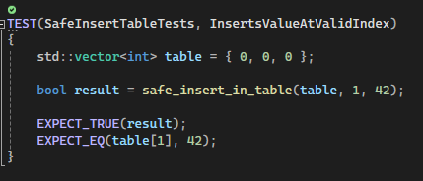
Unit Test 1: Does the function insert a value correctly when the index is valid?
This positive test verifies that the safe_insert_in_table function behaves correctly when supplied with a valid index. The test initializes a vector with three elements, attempts to insert a value at a valid position, and confirms that the function returns true and updates the vector as expected. This demonstrates compliant behavior under STD-008-CPP by ensuring that container access remains within valid bounds and does not cause memory corruption or undefined behavior

Slide 10
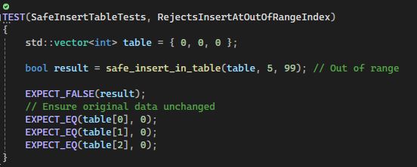
Unit Test 2: Does the function safely reject insertion when the index is out of range?
This negative test confirms that safe_insert_in_table properly detects and rejects an out-of-range index. The test attempts to insert at a position beyond the vector's size and verifies that the function returns false without altering the data. This behavior shows compliance with STD-008-CPP by preventing memory corruption, buffer overflows, and undefined behavior from invalid container access.

Slide 11
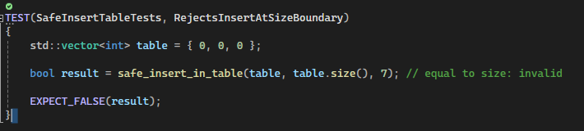
Unit Test 3: Does the function prevent insertion when the index equals the container size?
This negative test checks how the safe_insert_in_table function handles an index equal to the vector’s size, which is a common boundary error that results in out-of-range access. Although the index looks valid, it actually lies just outside the container’s limits. The test makes sure the function returns false and does not change the vector. This confirms compliance with STD-008-CPP by ensuring strict bounds checking and preventing undefined behavior.

Slide 12
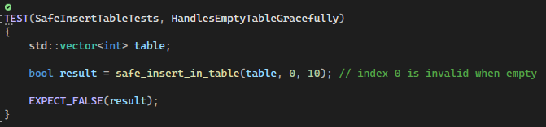
Unit Test 4: Does the function prevent insertion when the index equals the container size?
This negative test confirms that safe_insert_in_table correctly rejects insertion attempts when the vector is empty. Without valid indices, any access request is inherently out of bounds. The function should return false and not perform any operations on the container. This test highlights proper handling of edge cases and enforces compliance with STD-008-CPP by ensuring the function prevents invalid writes even in minimal or uninitialized data structures.

Slide 13
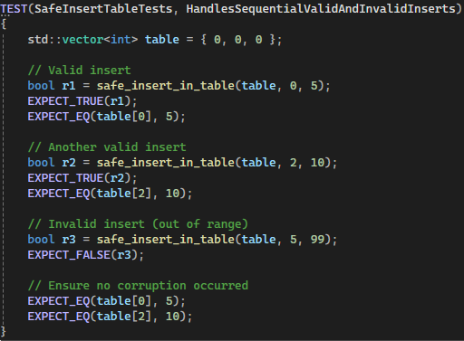
Unit Test 5: Does the function behave correctly across multiple sequential insert attempts?
This test assesses how safe_insert_in_table performs when multiple valid and invalid operations run in sequence. The goal is to verify that earlier valid writes succeed, while later out-of-range operations are safely rejected without corrupting previously modified data. This test shows compliance with STD-008-CPP by confirming consistent bounds checking, predictable behavior during repeated use, and resilience against cumulative errors.

Slide 14

AUTOMATION SUMMARY

Slide 15
TOOLS
Automation Across the DevSecOps Pipeline
Automation supports continuous enforcement of secure coding standards throughout all lifecycle stages.
Planning & Design
Automated dependency and architecture checks identify risks early.
Tools validate design decisions against Green Pace security policies.
Build Stage
Static analysis tools (CodeSonar, Clang-Tidy, Parasoft C/C++test, Polyspace, Coverity) scan for:
Memory errors
Type conversion issues
SQL injection risks
Resource misuse
CI pipelines fail builds automatically when violations occur.
Verify & Test
Automated unit tests, integration tests, SAST/DAST scans, and fuzzing ensure functional and security compliance.
Transition to Production
Automated configuration validation checks encryption settings, compiler flags, and resource controls.
Ensures deployments meet security baselines before release.
Monitor & Respond
Runtime monitoring tools detect anomalies and privilege misuse.
Automated alerts trigger rapid containment and response actions.
Overall Benefit
Provides layered, repeatable security checks aligned with Green Pace’s defense-in-depth strategy.

Slide 16
RISKS AND BENEFITS
Benefits of Acting Now
Reduces exposure to high-risk vulnerabilities such as SQL injection, memory misuse, and out-of-bounds access.
Prevents system crashes, data corruption, and potential breaches before they occur.
Lowers long-term remediation costs by identifying and fixing issues early in the lifecycle.
Improves overall system stability, reliability, and code maintainability.
Ensures compliance with Green Pace’s defense-in-depth strategy and secure development standards.
Risks of Delaying Remediation
Increases the likelihood that vulnerabilities will be exploited in production systems.
Expands the attack surface and allows minor defects to evolve into larger architectural problems.
Raises the cost and complexity of future fixes, especially for memory and data-handling issues.
Reduces transparency and weakens safeguards built into CI/CD and automated testing.
Slows development velocity due to unexpected failures, instability, or security incidents.
Strategic Takeaway
High-priority vulnerabilities must be addressed immediately.
Lower-priority issues should be incorporated into routine development cycles to maintain long-term security and quality.

Slide 17
RECOMMENDATIONS
Address Remaining Gaps
Improve documentation and enforcement for exception handling and file resource lifecycle standards.
Strengthen validation requirements for data passed into external subsystems or services.
Ensure consistent use of memory-safe patterns across all C/C++ modules.
Adopt Additional Security Standards
Incorporate modern secure memory allocation practices to prevent leaks and corruption.
Transition to safer string-handling libraries and patterns where applicable.
Update encryption practices to align with evolving cryptographic standards.
Enhance Automation and Testing
Expand automated static and dynamic analysis coverage for lower-priority standards.
Increase unit test coverage, especially for boundary conditions and failure handling.
Integrate early threat modeling into design workflows to catch vulnerabilities before implementation.
Strengthen Operational Practices
Conduct regular policy reviews and developer security training.
Improve logging and oversight for privileged actions to support compliance and auditing.
Promote proactive monitoring and continuous improvement as the development team scales.

Slide 18
CONCLUSIONS
Strengthening Long-Term Security
Adopt forward-looking secure coding standards to anticipate emerging threats.
Expand automation and testing to ensure continuous detection of vulnerabilities.
Increase observability and monitoring to maintain real-time awareness of system behavior.
Focus Areas for Future Protection
Prioritize strict memory safety, input validation, and error-handling consistency.
Enhance authentication, authorization, and encryption standards as technologies evolve.
Implement stronger compiler hardening options and modernized cryptographic practices.
Sustaining a Proactive Security Framework
Conduct regular reviews and updates to the Green Pace security policy.
Use SEI CERT and industry-aligned standards to guide improvements.
Maintain a continuous cycle of assessment, automation, and refinement to support secure, high-quality software development.

Slide 19
REFERENCES
CWE. (2025b, September 6). Common Weakness Enumeration. https://cwe.mitre.org/
Microsoft (2025, November 5). Build Reliable and Secure C++ Programs. Microsoft Learn. https://learn.microsoft.com/en-us/cpp/code-quality/build-reliable-secure-programs?view=msvc-170
OWASP. (2023, May 17). Secure coding practices. OWASP Secure Coding Practices - Quick Reference Guide | Secure Coding Practices | OWASP Foundation. https://owasp.org/www-project-secure-coding-practices-quick-reference-guide/stable-en/02-checklist/05-checklist
Parasoft. (n.d.). Comprehensive Test Automation Solutions for C/C++ Software Development. https://www.parasoft.com/products/parasoft-c-ctest/
Rose, S., Borchert, O., Mitchell, S., & Connelly, S. (2020, August). Zero Trust Architecture. NIST Special Publication. https://nvlpubs.nist.gov/nistpubs/specialpublications/NIST.SP.800-207.pdf
Schiela, R. (2024, February 14). SEI CERT C++ Coding Standard. SEI CERT C++ Coding Standard - SEI CERT C++ Coding Standard - Confluence. https://wiki.sei.cmu.edu/confluence/display/cplusplus
Svoboda, D. (2024, April 4). SEI CERT C Coding Standard. SEI CERT C Coding Standard - SEI CERT C Coding Standard - Confluence. https://wiki.sei.cmu.edu/confluence/display/c

